Slide 1
Membership Promotion (MP)
REPORTS II

Slide 2
Purpose
Beyond running reports, what else can we do with member data?
PAOE – how to get the points for each line
Mail merging
Weekly/monthly reports
Cater chapter programs to member needs
Record meeting attendance
Manage local dues collection
Determined Area Assigned Members

Slide 3
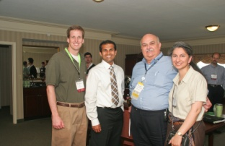
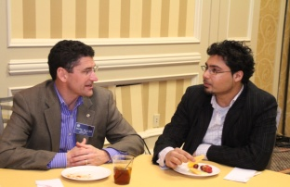
Reports Available
What reports do we offer?
Chapter master membership list report
  Tells you area assigned members!
Chapter change detail report by date
Chapter change summary report by date
Chapter dues paid to society report by date
New member report by date
Chapter delinquency report by date
Chapter cancellation (last 36 months) list
Chapter sign in sheet
YEA Connection

Slide 4
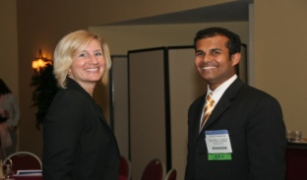
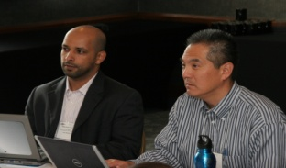
PAOE
How do I use reports to obtain my PAOE points?
During the year:
10 points for each upgrade from associate to member
  Chapter Change Report
25 points for each new member in Young Engineers in ASHRAE (YEA) category
  (300 points max)
  Run ASHRAE Yea Connection
  Filter for original election date

Slide 5
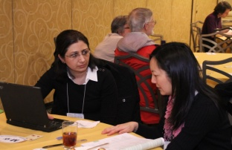
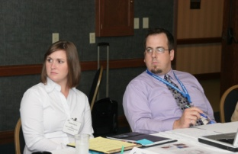
PAOE
How do I use reports to obtain my PAOE points?
Year end:
300 points if annual chapter goal is met
  50 additional points for each percent increase in area assigned member growth beyond annual goal
200 points if Society membership delinquencies in chapter are 3% or less of total Chapter AAM
25 points for retention of each new member (dues paid second and third year) 300 points max

Slide 6
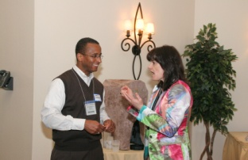
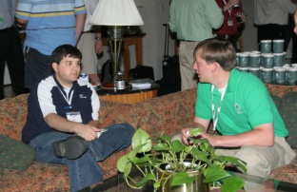
Mail Merging
Can I communicate to several members in one step?
You can send one email with variable data to several recipients
Welcome new members
Contact Delinquent members
Enlist members for help on something
Invite YEA members to YEA night
Invite certain people to MP night
GoTo “Instructions” Folder in MP Memory Stick

Slide 7

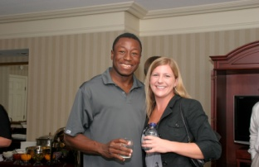
Staying on Top of New/Lapsed Members
What is the best way to do this?
You get an email for each new member
You get an email on the 1st for each past due members
Run new members and email them
Members only go past due on the 1st
  Run lapsed members on the 2nd

Slide 8

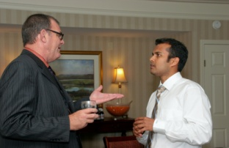
Member Data & Programs
Can I use member data to help CTTC effectively plan programs?
MP has the data – help your CTTC
Columns AP–BG in chapter member master
  Information about their company type/function
  Technical areas of interest
Age – younger members might be interested in fundamentals
Survey members – in April, survey all members on their interests – why guess?

Slide 9
Reports Tools
What will help me with learning chapter reports?
Instructions are available online and the blog
Learn how to run them early in the year
Get familiar with your data early
Contact staff at membership@ashrae.org
Use Internet Explorer when running reports
Clear your cache before running reports
Know your ASHRAE.org login
Create a folder to store your monthly reports

Slide 10
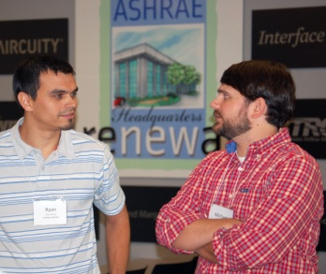
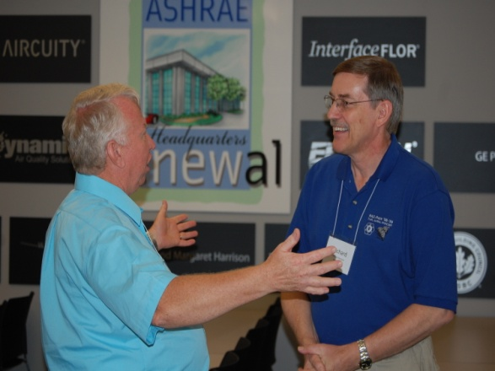
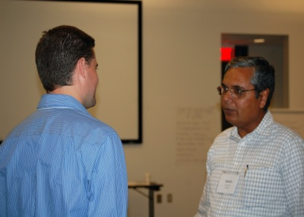
Group Discussion
What questions do you have?
Membership Reports
All of the MP training materials can be found at: www.mptraining.weebly.com
Staff Support
You have two staff contacts at ASHRAE Headquarters in Atlanta, GA, USA. They are:
Daniel Gurley, Manager of Membership
Email address: dgurley@ashrae.org
Phone: (678) 539-1127
Rhiannon Masterson, Asst Manager of Membership
Email address: rmasterson@ashrae.org
Phone: (678) 539-1178

