Slide 1
Membership Promotion (MP)
REPORTS

Slide 2
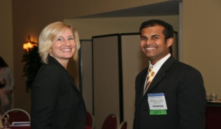
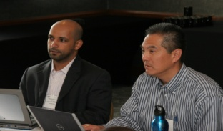
Purpose
What information can we obtain from chapter reports?
Current members
Lapsed members
New members
Chapter dues received by Society
Cancelled members for prospect lists
YEA and student members
Changes in member data

Slide 3
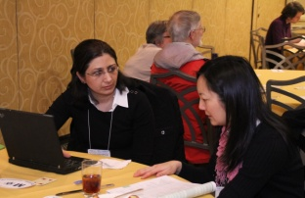
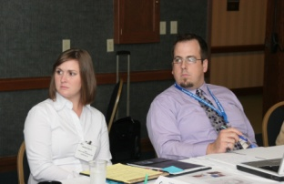
How to Run Chapter Reports
How do I run chapter reports online? (Steps 1-6)
Use Internet Explorer with pop-ups enabled
Login at ASHRAE.org
  Email address and password
Under Society Groups tab, select ‘Chapters’
Under Chapters, click ‘Run Reports’
Click on chapter name in center of screen
Click on ‘Run Chapter Reports’

Slide 4
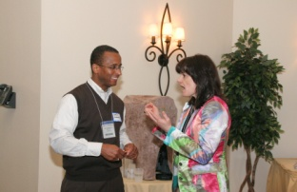
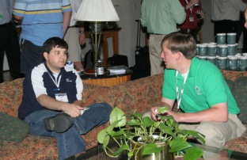
How to Run Chapter Reports, Cont.
How do I run chapter reports online? (Steps 7-10)
Select the report you wish to run
For reports with prompt dates:
  Enter info requested (e.g. 7/1/2012 and 6/30/2013 for begin and end dates)
  Click the ‘Go’ button
Your report will appear – open or save it
Questions? Email membership@ashrae.org

Slide 5

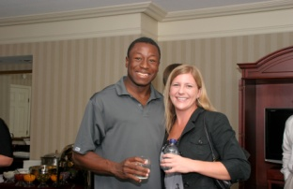
Reports Available
What reports do we offer?
Chapter master membership list report
Chapter change detail report by date
Chapter change summary report by date
Chapter dues paid to society report by date
New member report by date
Chapter delinquency report by date
Chapter cancellation (last 36 months) list
Chapter sign in sheet
YEA Connection

Slide 6
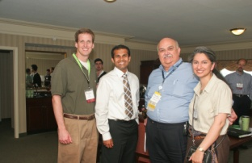
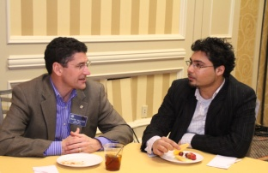
Key Membership Reports
If I do nothing else, what reports MUST I run?
Chapter master list highlights:
YEA members
  Run ASHRAE YEA Connection
Retained members
  Filter by election date (from previous two years)
Possible membership advancements
  >12 years of membership and Associate
  PE license and Associate
  Upcoming students to transfer (by grad date)

Slide 7

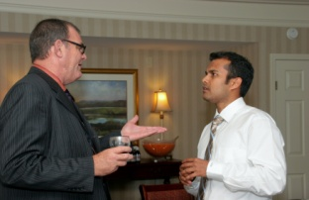
Key Membership Reports, Cont.
If I do nothing else, what reports MUST I run?
Chapter delinquency report by date
  Easy to print and share for a calling campaign
  You will receive an email for every lapsed member
New member report by date
  Easy to print and share for welcome calls
    Welcoming new members is key for retention
  You will receive an email for every new member

Slide 8
Reports Tools
What will help me with learning chapter reports?
Instructions are available online and the blog
Learn how to run them early in the year
Use email merge in Outlook!
Contact staff at membership@ashrae.org
Use Internet Explorer when running reports
Clear your cache before running reports
Know your ASHRAE.org login
Create a folder to store your monthly reports

Slide 9
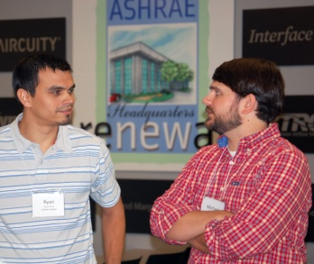
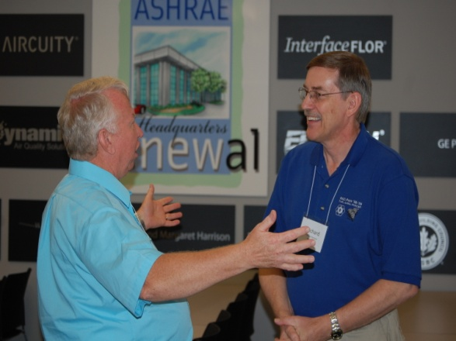
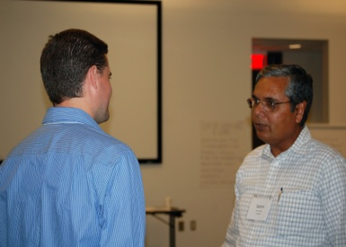
Group Discussion
What questions do you have?
Membership Reports
All of the MP training materials can be at: www.mptraining.weebly.com
Staff Support
You have two staff contacts at ASHRAE Headquarters in Atlanta, GA, USA. They are:
Daniel B. Gurley, Manager of Membership
Email address: dgurley@ashrae.org
Phone: (678) 539-1127
Rhiannon Masterson, Asst Manager of Membership
Email address: rmasterson@ashrae.org
Phone: (678) 539-1178

