Slide 1
Membership Promotion (MP)
RETENTION II

Slide 2
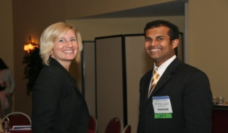
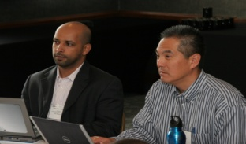
Your Role in Retention #1
What are the MP chair responsibilities for retention?
Work with CTTC for attractive programs
Know your members and recognize them
Create retention programs
Track members, particularly 90-180 days past due
Focus on new members
Engage YEA members

Slide 3
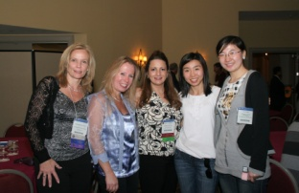
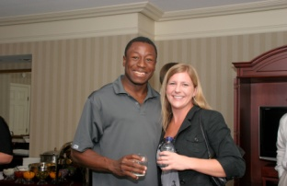
Your Role in Retention #2
What are the chapter responsibilities for retention?
Offer good programs
  Don’t guess - survey your members
  Use member data to identify possible topics
Put effort into good promotions and publicity
  Promote outside of ASHRAE
  Use allied associations (USGBC, AIA, AEE)
Encourage the development/support of local MP Committee
  Chapter should encourage a team of membership experts, not a sole chair

Slide 4
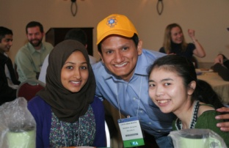
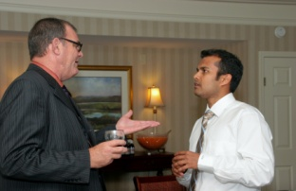
Retention Programs
What ideas are available for retention programs?
Membership nights
Regular reminders
  Through chapter communications
Calling campaigns
Mentoring programs
YEA Programs

Slide 5
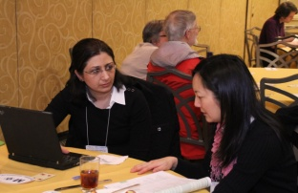
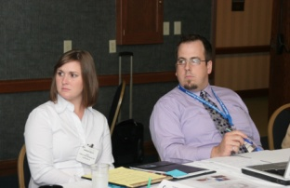
Membership Nights
What should chapters do for membership nights?
Ensure they have a purpose and a plan
Focus on thanking and recognizing members
Remind members of member benefits
Share new ASHRAE technical advancements
Engage members – create opportunities
  Connect members to mentors
  Volunteering
Offer a small incentive at the meeting for anyone who renews or joins at the meeting
Facilitate informal awards for recognition

Slide 6
New Members
The minute a new member joins, retention begins!
Invite new members to attend chapter board meeting
Invite new members to membership promotion night
Call and welcome new members – answer questions
Assign a committee member to each new member
  Seek them out and connect them to other members
Assign a mentor to new members if interested
Explain the chapter events and programs schedule
Offer small or introductory involvement opportunities
  Examples: help with the newsletter, help with an event
Ensure new members understand member benefits

Slide 7
New Members & Chapter Meetings
How can I support new members at chapter meetings?
Have new member badge or sticker
Ensure chapter members welcome them
Recognize them
  Have them stand and be introduced to the chapter
  Recognize their companies for their support
Have a “leadership opportunities” available at every meeting
Offer a new member orientation session

Slide 8
New Member Orientation
What is the purpose of new member orientation and what should I arrange?
Serve snacks
Bring membership pins
Bring new member badges
Introductions and testimonials
Society
  About ASHRAE and its purpose
  History
  Organization of leadership
  Membership basics and YEA
Chapter
  About the chapter
  Schedule of events
  Organization of leadership
  Regional basics

Slide 9
New Member Engagement
You have welcomed them and oriented them, so what’s next?
Follow up with them after their first meeting
Provide the same welcoming attitude at next meeting
Ask for feedback about orientation
Ask for feedback about their first meeting experience
Get commitments from them
  Participation
  Volunteerism
Stay in touch with them all year
Send them a thank-you letter, encourage renewal

Slide 10
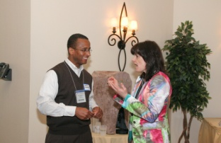
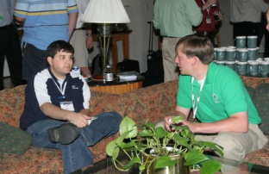
Mentoring
Who should be mentored and what is the role of a mentor?
New members for support and expertise
Helps mentors grow as leaders
Essential for growth of chapter/membership
YEA has a mentoring program
  www.ashrae.org/yea
Chapters can get PAOE points for using YEA mentoring program

Slide 11
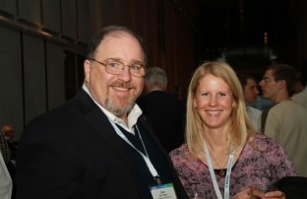
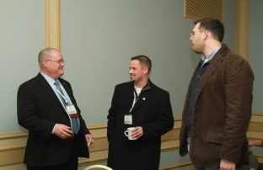
YEA Institute
What other programs does YEA offer to support retention?
Who are my YEA members?
  Affiliate, Associate or Member
  Age 35 and younger
Provides educational and leadership opportunities
Programs/resources
  Member spotlights
  Mentoring programs
  Recommended chapter programs
  Facebook presence with regular updates
  Society conference events
  Leadership weekend
  LeadershipU
www.ashrae.org/yea

Slide 12
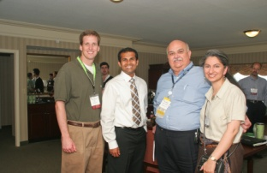
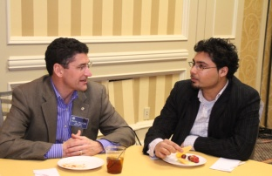
Retention Reminders
What must I remember when creating retention programs?
Membership lasts one year – 12 months
Associates /Members can renew for three years
The day after members expire until 90 days past due
  = Active and unpaid
90 – 180 days past due
  = Active and in grace status
181 days past due
  = Cancelled
Cancelled members cannot renew online
  They can reJOIN online (reinstating with application)
Cancelled members can reinstate with back dues
  Maintains original election date
  Contact membership@ashrae.org

Slide 13
Calling Campaigns
How should I organize my calling campaign?
Create a retention subcommittee and get help
Use discretion is selecting callers
Teach callers phone etiquette – Google tips
Calls can sometimes be difficult – teach listening
Break members into types or delinquency dates
Be sure you have prepared your callers
  Updated membership/delinquency list
  Benefits, latest advancements, upcoming events
  Instructions for helping members renew
Track your success

Slide 14
Calling Tips
How can I ensure I will have successful conversations?
Treat each call as if it is the only one you are making that day
Create positive mental image of person you’re calling
Listen
Get to know your prospect
Always identify why you're calling and be positive
Never be apologetic for what you are doing
  You are a volunteer working for a great organization
Be brief, speak clearly, smile
Ensure they can hear you but don’t shout
Listen and be courteous

Slide 15
Sample Calling Scripts
What do we say to the members we call?
“Hi, this is <name> calling on behalf of the local ASHRAE <chapter>.”
“Is now a good time for you to talk for just a few minutes?”
“A review of the chapter’s membership records indicate your Society membership has not been renewed.”
“I would like to take a few minutes to talk with you about membership and answer any questions you might have.”
  This is a good time to listen in for why they have not renewed and provide information that might help them
  This is a good time to remind them of the benefits of membership, notify them of any industry advancements and listen in for any feedback
  Your goal is to find out why they have not paid their dues without directly asking them, and to create a call to action in them to pay their dues
“Thank you for speaking with me today, and for being an ASHRAE member.”

Slide 16
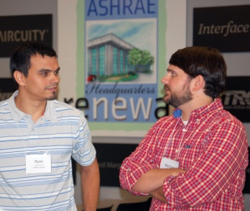
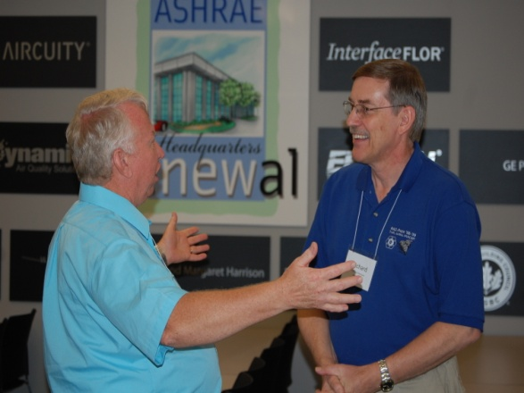
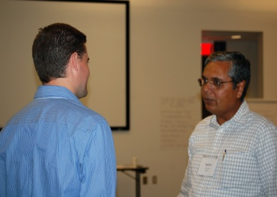
Group Discussion
What questions do you have?
Retention of Members
All of the MP training materials can be found at www.mptraining.weebly.com
Staff Support
You have two staff contacts at ASHRAE Headquarters in Atlanta, GA, USA. They are:
Daniel B. Gurley, Manager of Membership
Email address: dgurley@ashrae.org
Phone: (678) 539-1127
Jeanette McCray, Asst Manager of Membership
Email address: jmccray@ashrae.org
Phone: (678) 539-1178

