Slide 1
Marketing Member Benefits, Publications, Discounts
Notes:
We know how vital ASHRAE is in our daily lives, but it may slip the minds of those not directly involved in the HVAC&R industry. The benefit provided by ASHRAE to everyday life and its impact like the technology itself is hidden. How can we let others, such as building owners, facilities managers and government officials, become more aware of the role that ASHRAE creating the environments we live in. The answer is in the hands of every ASHRAE chapter and every ASHRAE member.

Slide 2
Benefits
Access to members only portion of the website
ASHRAE Handbook
Issued in June annually
Example: if you join in September, you will receive your Handbook the following June
New Associates and Members receive 12-month one-time access to the Handbook Online while they await their first print/CD Handbook
ASHRAE Journal
HPB Magazine
Industry and Society newsletters

Slide 3
ASHRAE’s Many Influences
Documents to provide technical foundation for LEED
Energy standards referenced in building codes
Ventilation requirements for hospitals in federal guidelines
Thermal guidelines used by the IT industry for data centers
Designation scheme for refrigerants to establish safe use
Design parameters to determine comfort
Ventilation rates to provide healthy environments
Notes:
In addition to heating, ventilating, air conditioning and refrigerating, let’s take a look at some of the other aspects of our world that ASHRAE influences, and the standards and publications involved.

Slide 4
ASHRAE and LEED
ASHRAE Handbook
Commercial Building Energy Audits
ASHRAE Standard 62.1
ASHRAE/IES Standard 90.1
ASHRAE Standard 55
Advanced Energy Design Guides
ASHRAE Guideline 1.1
Notes:
Without ASHRAE references, there would not be much technical substance to the energy and indoor environment aspects of U.S. Green Building Council’s Leadership in Energy and Environmental Design (LEED). Energy audit guidance is provided by chapter 35”Energy Use and Management” in the Applications Volume of ASHRAE Handbook and the Commercial Building Energy Audits book. Indoor Environmental Credits included in LEED are based on Standard 62.1. References to 90.1 are prevalent in LEED. Standard 55 for thermal comfort, the Advanced Energy Design Guides, and Guideline 1.1 for commissioning all are important contributors to the effectiveness of LEED.

Slide 5
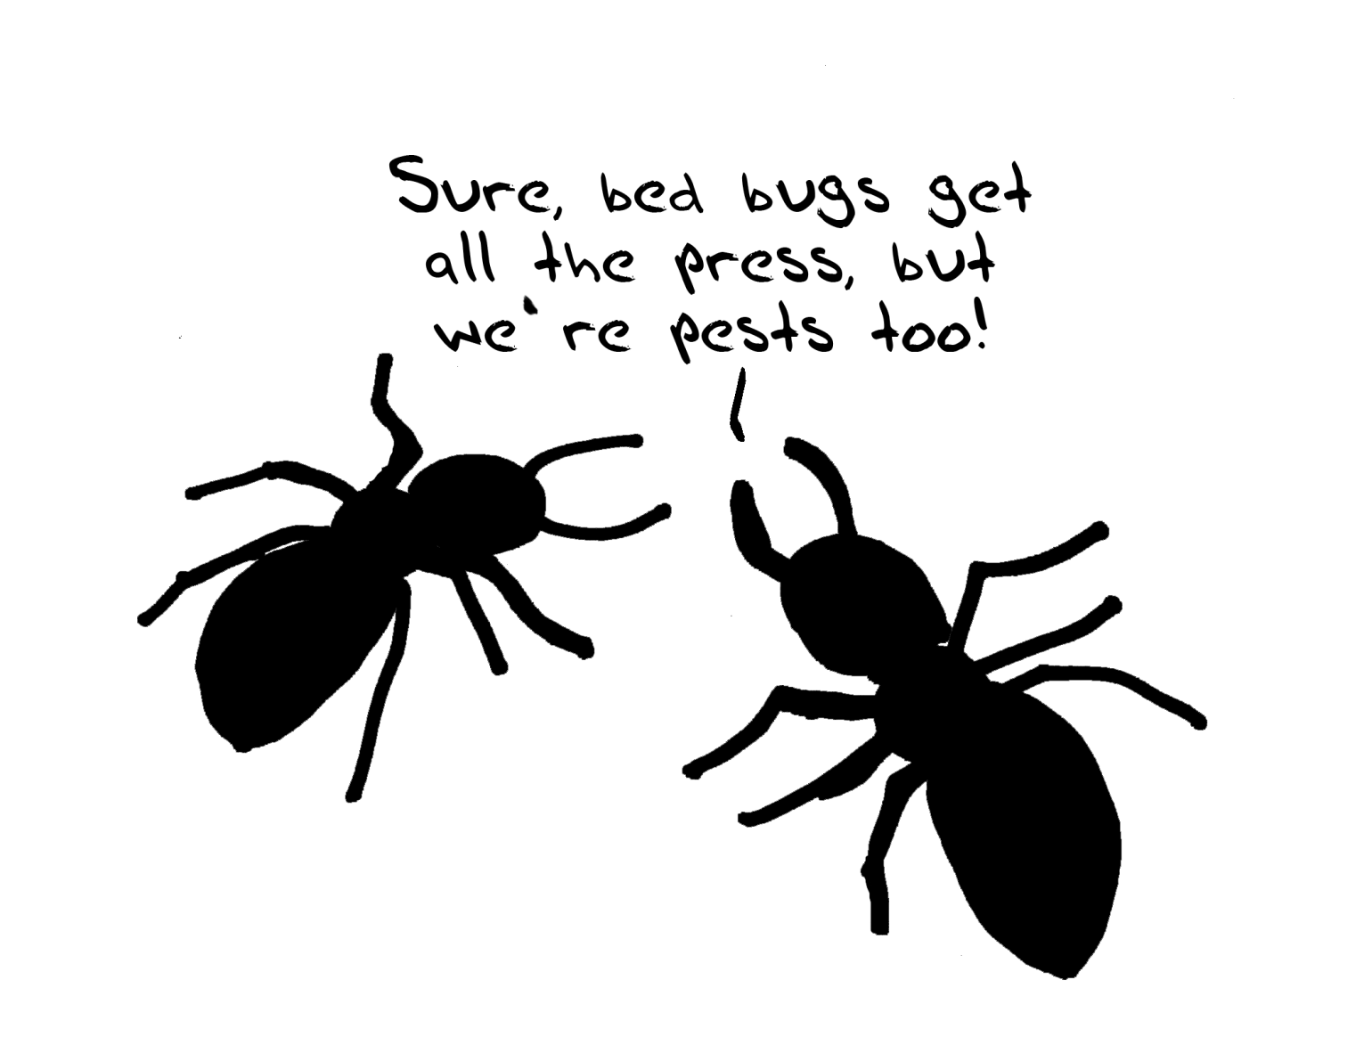
Notes:
But if you don’t tell your story, no one else will. To capitalize on its technical achievements and the contributions of its members, ASHRAE is always working to promote its accomplishments and communicating to the public and to related professional and business groups. We have a lot that we can talk about.
Our key audiences whom you may want to reach out to include
Current members
Potential members
Government officials (local/regional/state/federal)
Opinion leaders
General public
Model code officials
Building owners and managers
Industry stakeholders

Slide 6
Standard 189.1
Total building sustainability package for those who strive to design, build and operate green buildings
Site sustainability
Water use efficiency
Energy efficiency
Indoor environmental quality
Building impact on the atmosphere
Adopted by the U.S. Army as part of new sustainability policy
A j compliance option of the International Code Council’s International Green Construction Code
Notes:
In late 2009, ASHRAE, the Illuminating Engineering Society (IES) and the U.S. Green Building Council (USGBC) published the nation’s first code-intended standard for high-performance buildings. Standard 189.1, Standard for the Design of High-Performance, Green Buildings Except Low-Rise Residential Buildings. The standard is not a building rating system, but rather provides minimum requirements for high-performance, green buildings as developed through industry-wide consensus.
189.1 is more stringent than Standard 90.1 and contains mandatory provisions regarding indoor environmental quality. It also covers site sustainability, water use efficiency and the building’s impact on the atmosphere, materials and resources.
A few ways that people in the local community may see the effects of 189.1 are…(refer to slide)

Slide 7
Standard
Sets design requirements for the efficient use of energy in buildings
39 states have adopted some version of 90.1 as their energy code
2010 version referenced in the federal Energy Conservation and Production Act
Standard and user’s manual = indispensable tools for consulting offices, suppliers and facility managers
Notes:
Standard 90.1 sets design requirements for the efficient use of energy in buildings. Its requirements apply to:
the building envelope
distribution of energy
systems and equipment for auxiliaries
heating, ventilation, air conditioning, water heating
electric power and lighting.
The 2010 standard resulted in more than 30 percent energy savings can be achieved vs. the 2004 standard. Without plug loads, site energy savings are 32.6 percent and energy cost savings 30.1 percent. Including plug loads, the site energy savings are estimated at 25.5 percent and energy cost savings 24 percent.

Slide 8
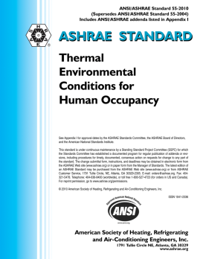
Standard 55
Sets the standard for what are considered “comfortable” indoor conditions for 80% or more of a building’s occupants
Settles the “too hot/too cold” debate at offices across the nation
Notes:
The standard specifies the combinations of indoor thermal environmental factors and personal factors that will produce thermal environmental conditions acceptable to 80 percent or more of the occupants.
Almost everyone has had run-in with coworkers over the fight to control the thermostat—Standard 55 directly affects the comfort of a person’s indoor environment, and they probably don’t even know it’s ASHRAE putting an end to the “too hot/too cold” debate. This standard is particularly relevant to building owners and managers, who must field these complaints.
These environmental factors include temperature, thermal radiation, humidity and air speed, while personal factors are activity and clothing.
To be specific, temperatures in the winter should range from 68-74°F and 73-79°F in the summer, according to the standard.

Slide 9
Standard 62.1
Specifies minimum ventilation rates and other measures intended to provide indoor air quality that is acceptable to human occupants and minimizes adverse health effects
Applies to all indoor or enclosed spaces that people may occupy, except where other applicable standards and requirements dictate larger amounts of ventilation
Notes:
The purpose of Standard 62.1 is to specify minimum ventilation rates and other measures intended to provide indoor air quality that is acceptable to human occupants and that minimizes adverse health effects.
The standard plays an important role around the world in providing for occupants’ well-being by improving indoor air quality. The standard provides guidance for the design and operation of HVAC systems for a range of building types and functions. It includes minimum requirements for maintaining a safe, healthy and comfortable indoor environment for building occupants.

Slide 10
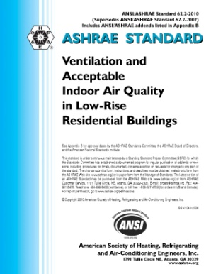
Standard 62.2
Defines the roles of and minimum requirements for mechanical and natural ventilation systems and the building envelope intended to provide acceptable indoor air quality in low-rise residential buildings
Limits sources of pollutants and requiring enough mechanical ventilation to provide dilution for unavoidable contaminants
Notes:
Standard 62.2 limits sources of pollutants and requires a small amount of mechanical ventilation to provide dilution for unavoidable contaminants in homes. The standard ensures that HVAC and other systems work together to effectively ventilate homes and minimize sources of indoor pollution.

Slide 11
Standard 170
Provides control for comfort, infection and odor in health care facilities, including:
Hospitals
Nursing homes
Outpatient facilities
Protects patients and healthcare workers from chemical, physical and biological airborne contaminants
Notes:
This standard defines ventilation system design requirements that provide environmental control for comfort, asepsis and odor in health care facilities
It provides control for comfort, infection and odor in health care facilities, including hospitals, nursing homes and outpatient facilities. The standard takes into consideration chemical, physical and biological airborne contaminants that can affect delivery of medical care to patients, the convalescence of patients and the safety of health care workers and visitors.
Standard 170 applies to new buildings, additions to existing buildings, and those alterations to existing buildings that are identified within this standard.

Slide 12
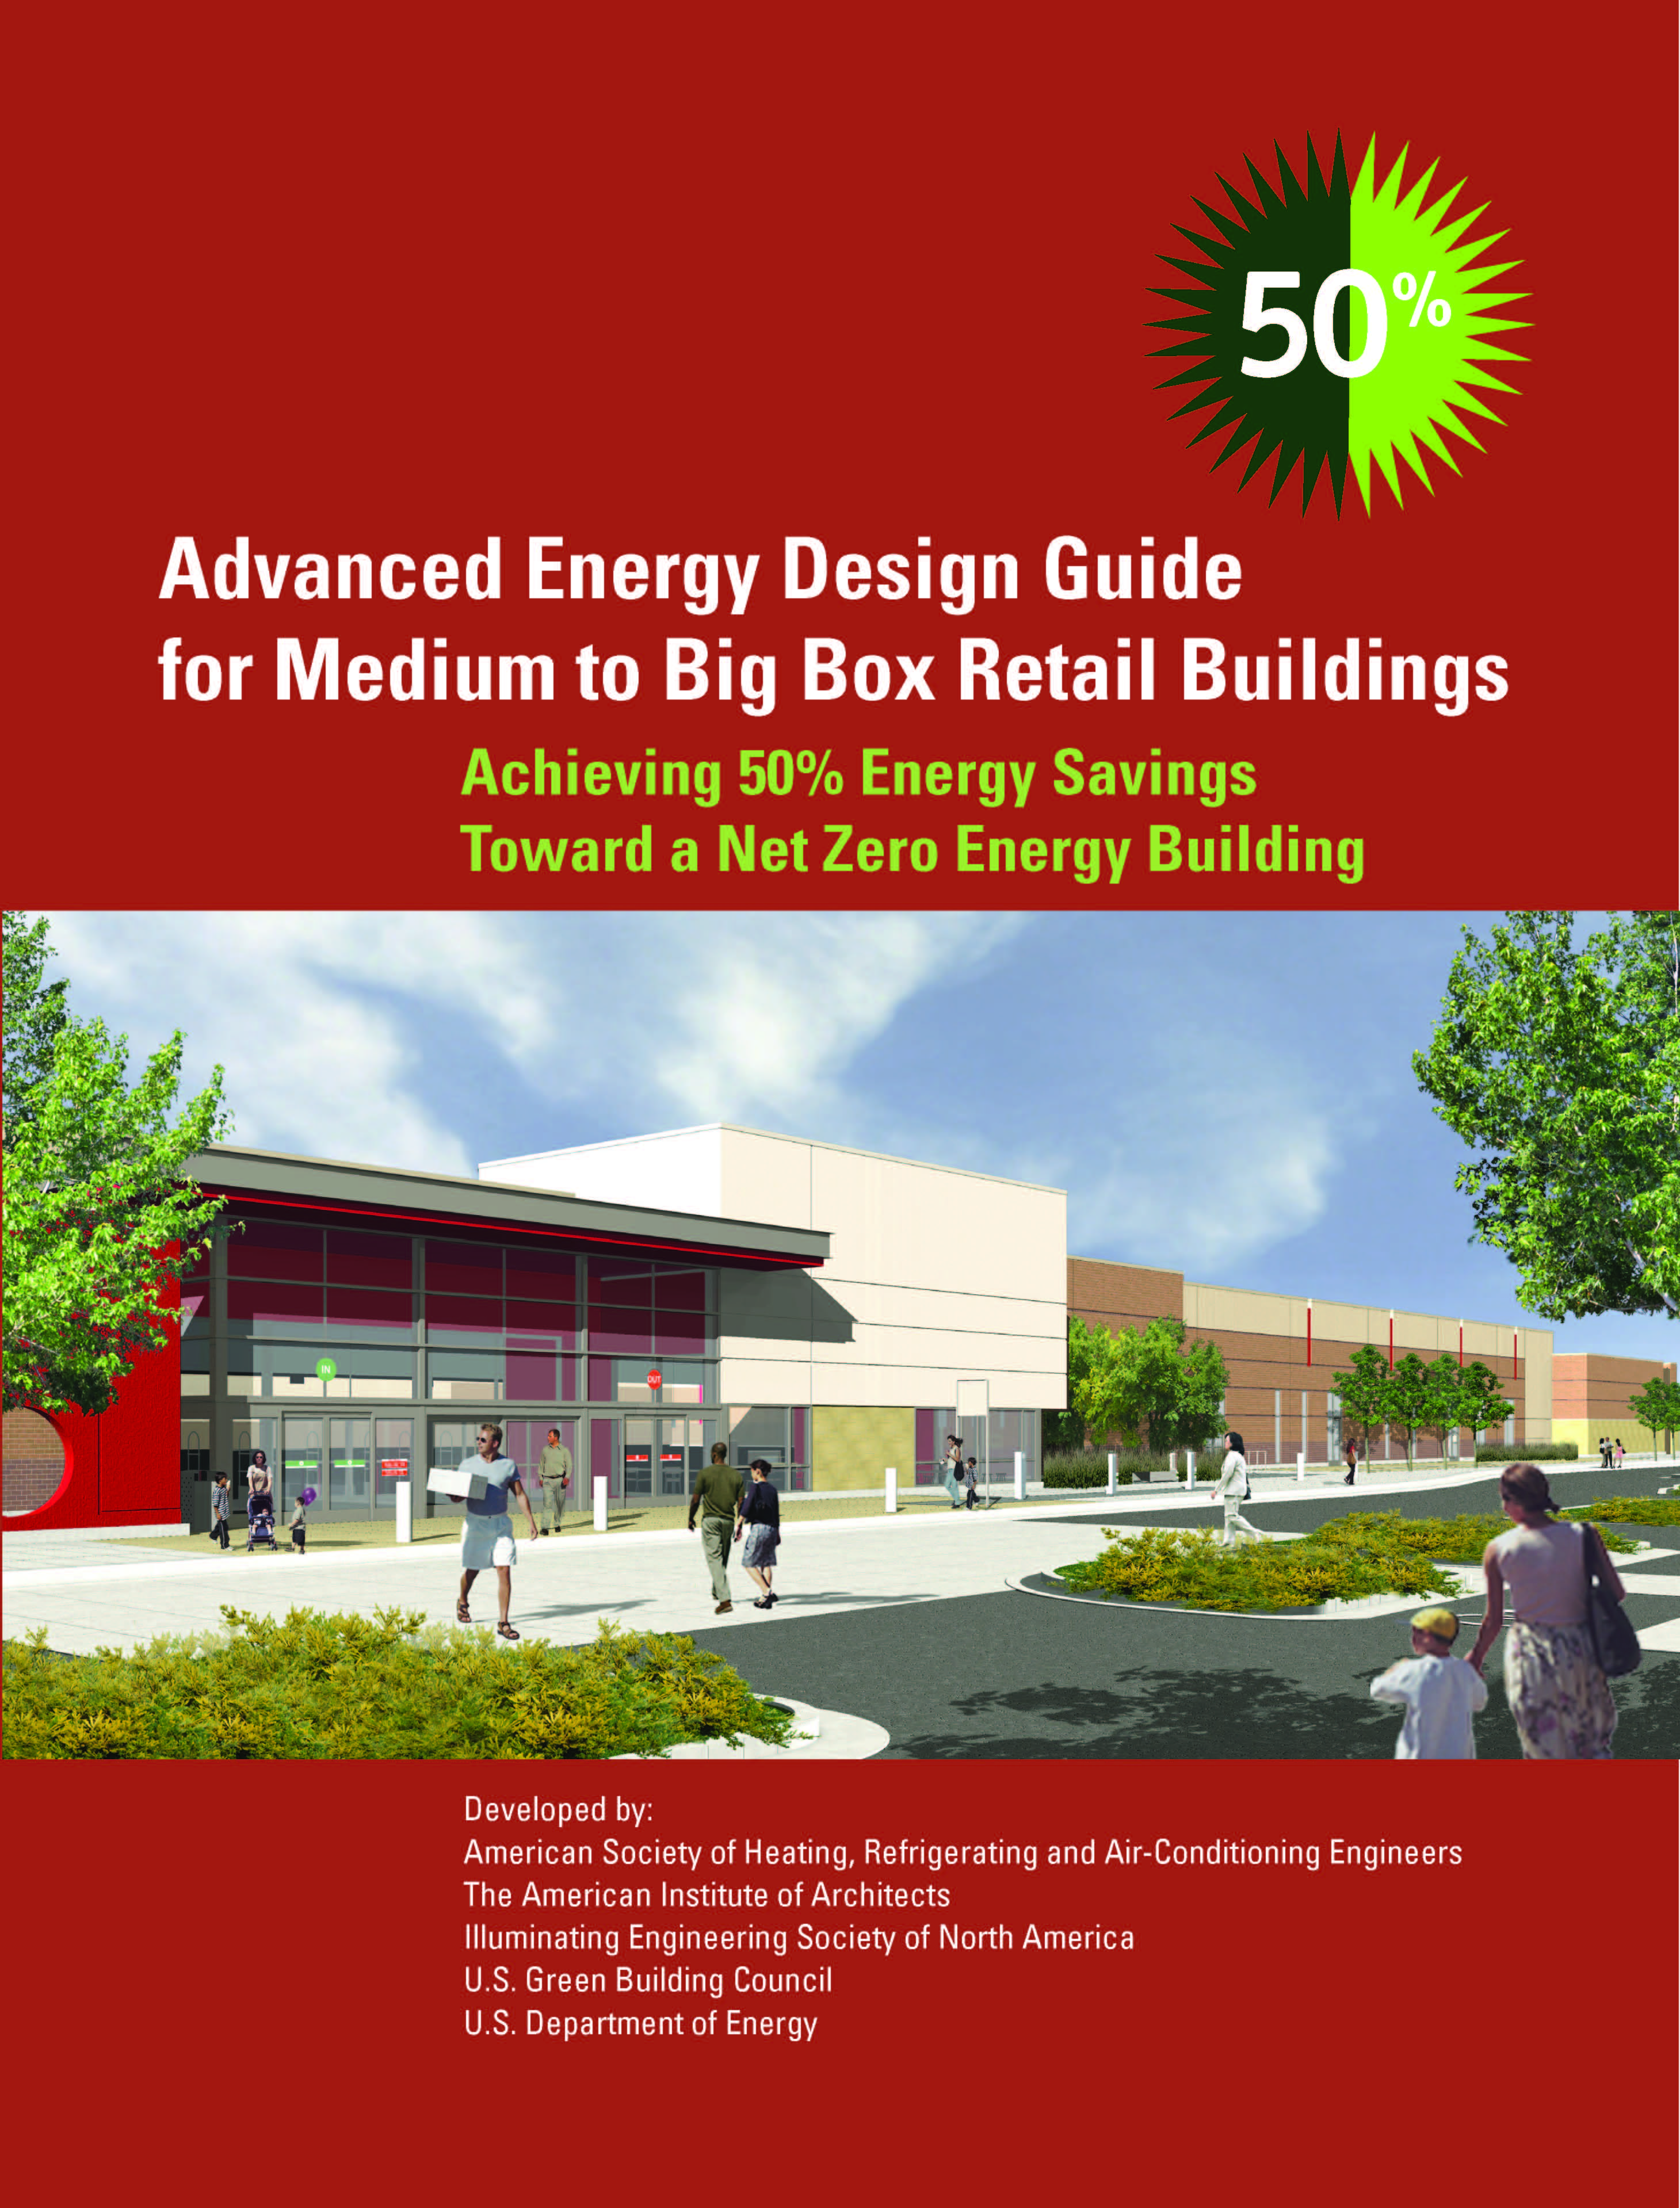
Advanced Energy Design Guides
Prescriptive pre-modeled solutions to reach a given energy savings for a given building type
More than 430,000+ copies in circulation
Part of ASHRAE’s commitment to energy optimization and producing guidance to move the building industry toward market-viable net zero energy and carbon neutral buildings
free download at ashrae.org/freeaedg
Notes:
The Advanced Energy Design Guide series provides a practical approach to achieve advanced levels of energy savings without having to resort to detailed calculations or analysis. The guides offer contractors and designers the tools, including recommendations and how-to guidance using off-the-shelf technology, needed for achieving 30% or 50% energy savings over minimum code requirements.
50% guides
K-12 schools
Small-medium offices
Mid-big box retail
Hospitals
30% Guides
Small hospitals
Highway lodging
Small warehouses and self-storage buildings
K-12 Schools
Small Retail
Small Offices

Slide 13
Secret of Successful Marketing
Target the audience
Tailor messages so the audience relates
Take advantage of opportunities to raise awareness of ASHRAE
Talks before civic groups
Letters to the editor
Interaction with local code writing groups
Joint programs with organizations that serve related professionals
Notes:
The secret of successful marketing is to communicate a message that the audience can relate to. For example, a home owner can be told to look their hot water tank in their house and to look for the reference to ASHRAE Standard 90.1 with energy efficiency information. Or if at the hardware store looking for the reference to ASHRAE Standard 52.2 on air conditioning filers. In a hospital, air is most likely circulated in accordance with ASHRAE Standard 170. And on air plane, the air quality is being investigated by ASHRAE research project. For each ASHRAE contribution think of a tangible example that the person you are speaking to can relate to. Civic groups are always on the look out for new topics.
Take advantage of opportunities. If there temperatures are unusually high, use the opportunity to speak with the local media about how newer air conditioning units are more energy efficient and provide improved performance. Be on the look out for opportunities to write letters to the editor or as is common now send a tweet or leave a facebook message with radio or TV stations.
Government is one of the most important audiences for ASHRAE audiences. Make sure local governments are aware of ASHRAE standards and ASHRAE certification programs.
And take advantage of opportunities to work with local chapters of related groups.

Slide 14
Guidance from ASHRAE
Speaking for the Society
ASHRAE news releases – www.ashrae.org/news
Manual of Chapter Operations
Advocacy Toolkit at www.ashrae.org
Notes:
ASHRAE encourages its members to spread the word about our good work. We believe that communicating to the public has important benefits, such as member recruitment and retention, building support for ASHRAE standards and the process by which they are developed, maintaining its status as the leading HVAC&R organization, public education and increased sales of products and programs
Here are some programs and services that may help you in spreading the word about ASHRAE.
Keep in mind that on any official basis, only the ASHRAE president is the chief spokesperson for the Society. When external contacts occur, the ASHRAE staff will identify the appropriate spokesperson for that topic. (ROB 1.201.036)

Slide 15
Discounts
15% off publications
Includes ASHRAE standards and guidelines
15% off member price on all Handbook products
During first year of membership
Excludes network versions
Member price on courses
Member price on certification
Member price on conference registrations
Group Insurance

