Slide 1


ASHRAE
Membership
Why you and your employees should be ASHRAE Members
Notes:
Title change -

Slide 2
ASHRAE
Facts
“ASHRAE” was founded in 1959, after a merger of ASHAE (1894) & ASRE (1904)
Headquarters in Peachtree Corners, GA
  Newly renovated (2021), Net-Zero Energy Building
Over 51,000 members in over 138 countries
  15 Regions
  199Chapters
  400+ Student Branches
  6,000+ Student Members

Slide 3
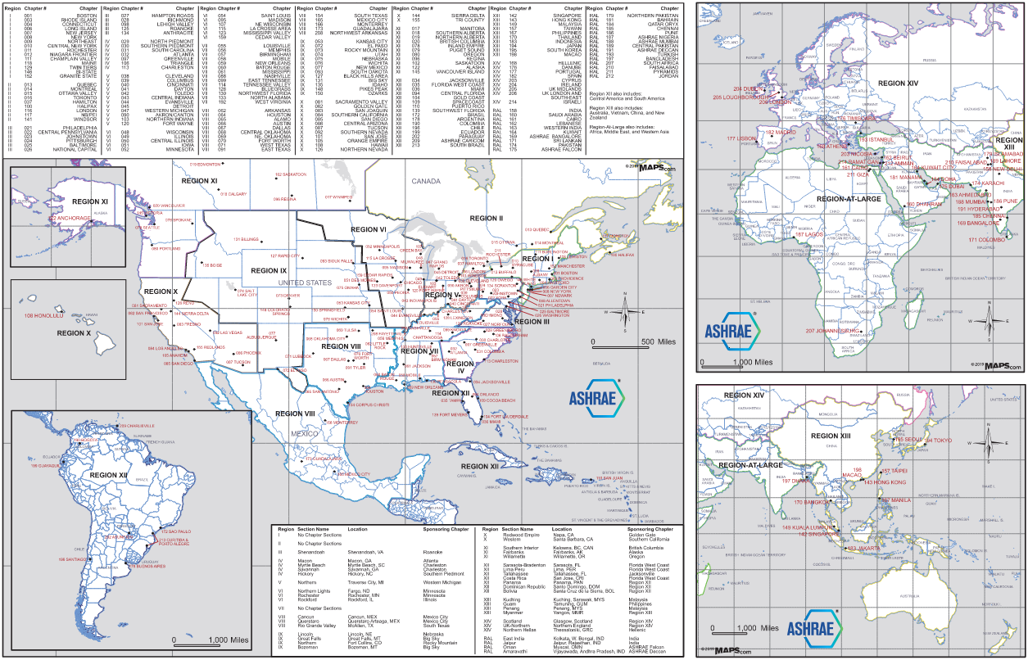
ASHRAE Map
We are GLOBAL!!

Slide 4
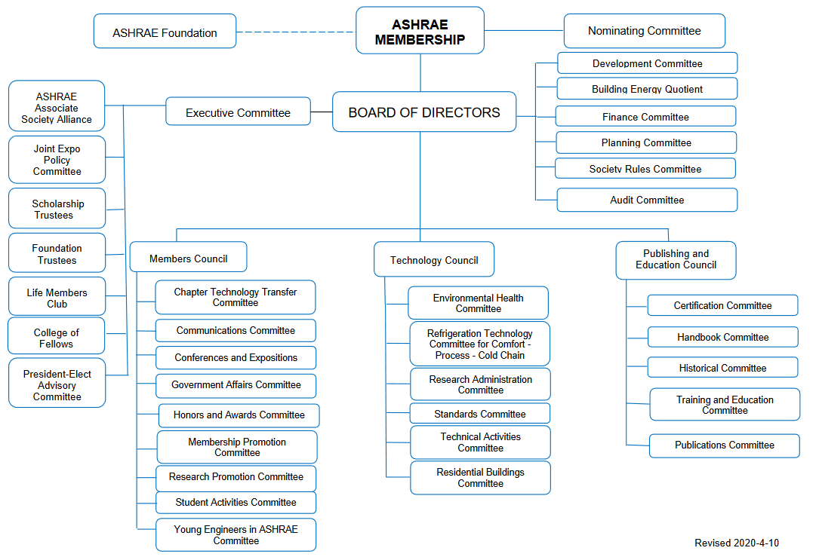
ASHRAE Structure
ASHRAE Structure

Slide 5




ASHRAE
Core Values
Excellence
Commitment
Integrity
Collaboration
Volunteerism
Diversity

Slide 6
The Benefits of ASHRAE
The opportunity to be a part of THE professional organization that defines the standards of OUR industry
Access to Industry Standards
Networking with Industry Leaders
Industry Recognition
Personal and Professional Development
Fun!
Career Advancement Opportunities

Slide 7
ASHRAE
Society Member Benefits
ASHRAE Handbooks, ASHRAE Standards & eLearning Courses
Subscriptions to ASHRAE Journal, ASHRAE Insights and High-Performance Building Magazine
Discounts on publications, educational courses, certification, and conference registration
Access to members-only sections of ASHRAE website
Member-only Insurance Plans

Slide 8
ASHRAE
Chapter Member Benefits
Demonstrates a commitment by YOUR company to the industry as a whole
Networking for personal and professional development for employees – many of YOUR customers are members
Educational opportunities tailored to regional aspects of OUR industry
Access to the other important industry participants to learn and share information

Slide 9




Who are ASHRAE Members?
Engineers / Consultants
Architects
Contractors
Building Owners
Facility Managers
Sales Engineers
Manufacturers
Teachers / Researchers
Students

Slide 10


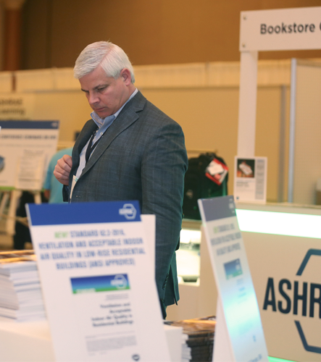
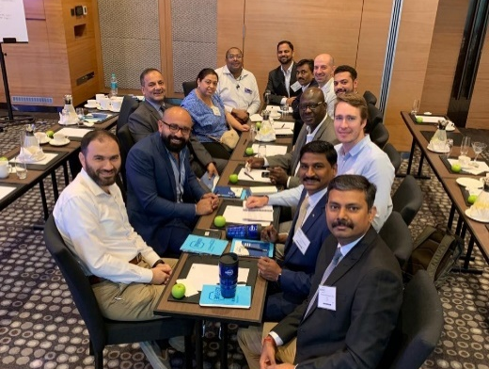
Employer Benefits
Professional development opportunities – both hard & soft skills
Access to technical resources
Direct access to new technologies and industry advancements
Networking opportunities
Increase company exposure in the industry
Shows dedication and commitment to their career in our industry
Your Company will benefit along with the employee

Slide 11
How to join ASHRAE
Online – www.ashrae.org/join
Mail printed application to ASHRAE HQ

Slide 12
Membership Grades
Member
  Twelve or more years experience in the built environment (includes education, professional licenses & work experience)
Associate
  Any applicant working in built environment industries.
Affiliate
  Introductory membership for applicants
    Age 30 and younger OR former Military who have been honorably-discharged in the past 5 years.
    New to the built environment industry.
Student
  Students in engineering, architecture, construction or food science academic programs

Slide 13
The opportunity to be a part of THE professional organization that defines the standards of OUR industry
ASHRAE Handbook
Subscriptions to ASHRAE Journal, ASHRAE Insights & High Performing Buildings Magazine
Discounts on publications, educational courses, certifications & conference registration
Leadership Training
Access to Industry Standards
Access to members-only sections of ASHRAE website
Member-only Insurance Plans
Networking
Industry Recognition
Personal and Professional Development
Fun!
Remember the Benefits?

Slide 14
Questions?
Notes:
Title change -

