Slide 1
Membership Promotion (MP)
ROLE of MP Chairs

Slide 2
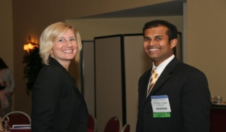
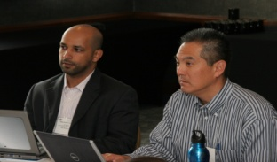
Purpose
What is the purpose of MP?
Publicize the aims, activities, achievements and scientific/educational purposes of Society to encourage membership growth
Monitors Society’s membership demographics and ensures individuals from multiple demographic backgrounds are equally attracted to ASHRAE
Provides training and support for chapter MP Chairs
Reports to Members Council on the needs of the entire membership

Slide 3
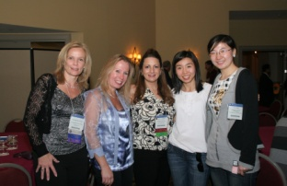
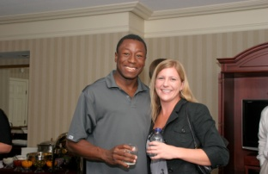
Role of Local MP Chairs
What are MP Chairs charged to do?
Sell ASHRAE – know ASHRAE
  Benefits and advantages
Connect and engage members
Diversify local chapter memberships
  Recruiting under-represented industry areas/firms
Reward and recognize members
Offer mentoring opportunities when needed
Know detailed list of duties and PAOE

Slide 4
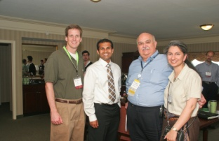
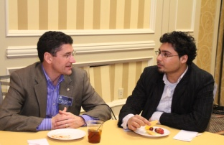
Role of Local MP Chairs
What are MP Chairs charged to do?
Create a chapter succession of MP experts
Support Young Engineers in ASHRAE (YEA)
Collaborate with Student Activities (SA) and YEA on student retention and transfers
Plan membership nights early and get them on the chapter calendar
Know your chapter data/how to run reports
Keep regular and open communication with your Regional Vice Chair (RVC)

Slide 5
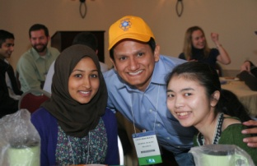
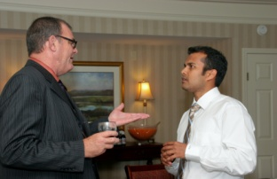
MP Chair Musts
Where does the MP Chair start and what is required?
Attend centralized training
Create a committee – it can’t just be you!
Set goals with your RVC: growth and retention should be your focuses
Effectively manage delinquent members
Prepare early:
  Know your member data
  Prepare your testimonial (why you joined)
  Have materials available (applications, brochures)

Slide 6
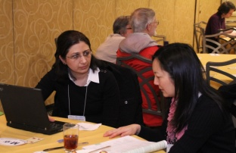
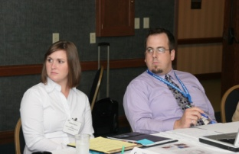
Supporting Your MP Committee
What is the most effective way to manage your local efforts?
Distribute workload evenly and appropriately
Create a competition and challenge them
  Reward and recognize them for their efforts
Be clear about responsibilities early: set goals
Be sure they have the training and materials they need to meet and exceed their goals
Offer leadership opportunities so they can improve their competencies
Create co-chairs for projects when needed:
  Campaigns
  Mentoring
  Membership Nights

Slide 7
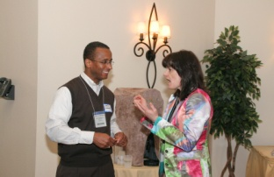
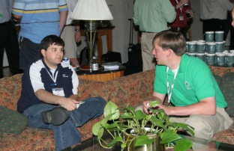
MP Chair Musts for Promotion
What must an MP Chair do to promote?
Have a PR plan in place early to:
  Increase public awareness locally
  Establish ASHRAE as a key resource for industry technical information
Work with chapter leadership to appoint a PR committee or chair
Be sure you know your PR targets early and you start promoting in July
Use local media to promote events
Promote with allied organizations via:
  Joint opportunities
  Technical topics of interest to their groups

Slide 8
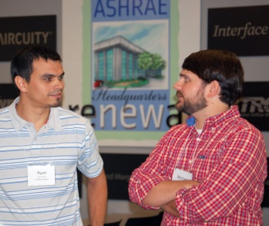
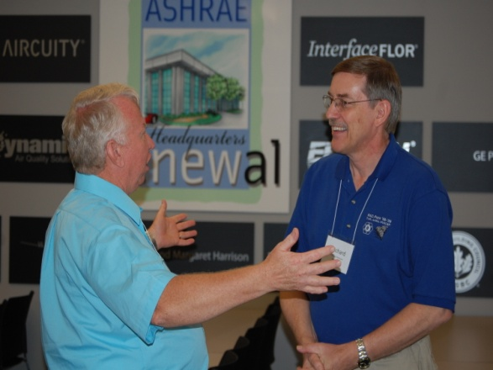
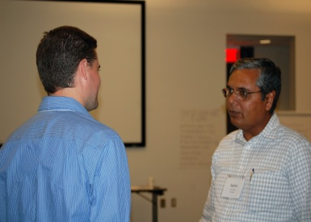
Group Discussion
What questions do you have?
Roles/Responsibilities
All of the MP training materials can be found at: www.mptraining.weebly.com
Staff Support
You have two staff contacts at ASHRAE Headquarters in Atlanta, GA, USA. They are:
Daniel B. Gurley, Manager of Membership
Email address: dgurley@ashrae.org
Phone: (678) 539-1127
Jeanette McCray, Asst Manager of Membership
Email address: jmccray@ashrae.org
Phone: (678) 539-1178

